Slide 1


# Effortless Sustainability Platform
Team HACTRIX is revolutionizing the reuse process by leveraging AI and community power. Our platform aims to make sustainable practices accessible and rewarding for everyone.
Notes:
1.7.2013
1
‹#›

Slide 2
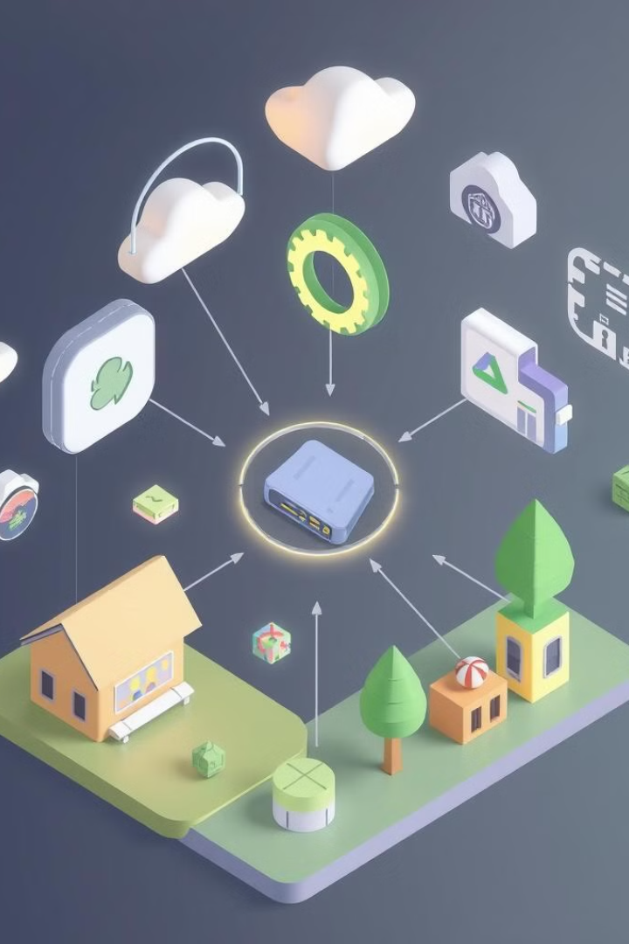

HACKYINTM -2k25
Team Name: HACTRIX
Domain: Sustainability & Smart Tech
Team Vision: To make sustainable living a default, not a choice
TEAM MEMBERS
AKASH N
AKASHMADHAV ELISHETTY
ALLOCIOUS FRANKLIN R
MOHAMED AL SILMI
Notes:
1.7.2013
2
‹#›

Slide 3
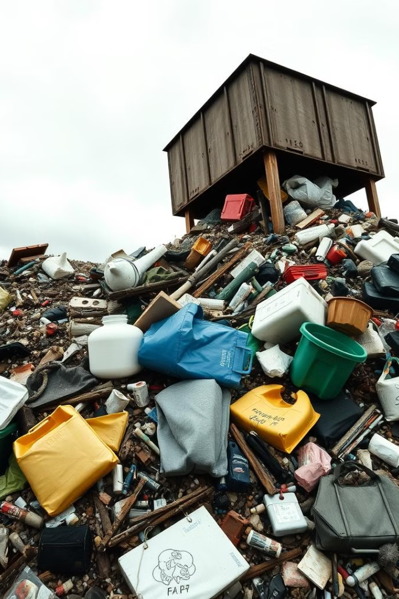
Problem Statement
🌍 Waste isn't the issue — inconvenience is.
🔄 Millions of usable items are trashed, while others go without.
🧩 Platforms today are built for profit, not for purpose.
📸 Manual uploads, zero rewards = no motivation to give back.
📍 No smart, local system to connect items with impact.
Notes:
1.7.2013
3
‹#›

Slide 4
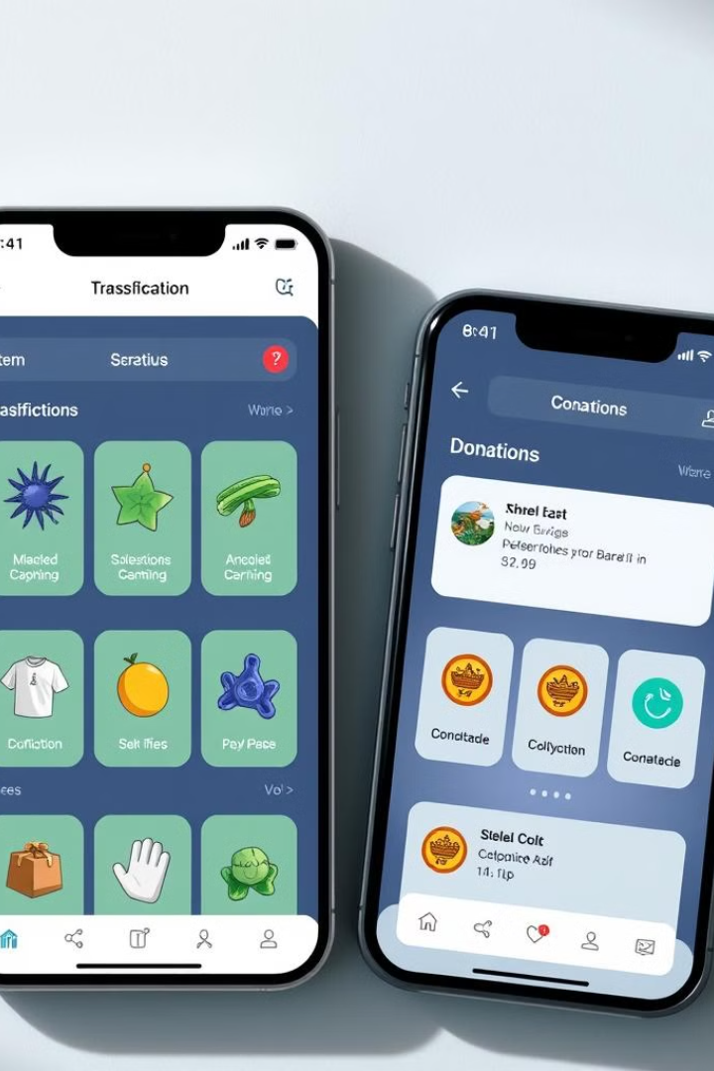
Our Solution
We offer an AI-powered website that simplifies item donation.
A gamified eco-score system drives engagement.
Geolocation matches users for hyperlocal sharing.
Voice and WhatsApp integration provides seamless listing.
Notes:
1.7.2013
4
‹#›

Slide 5
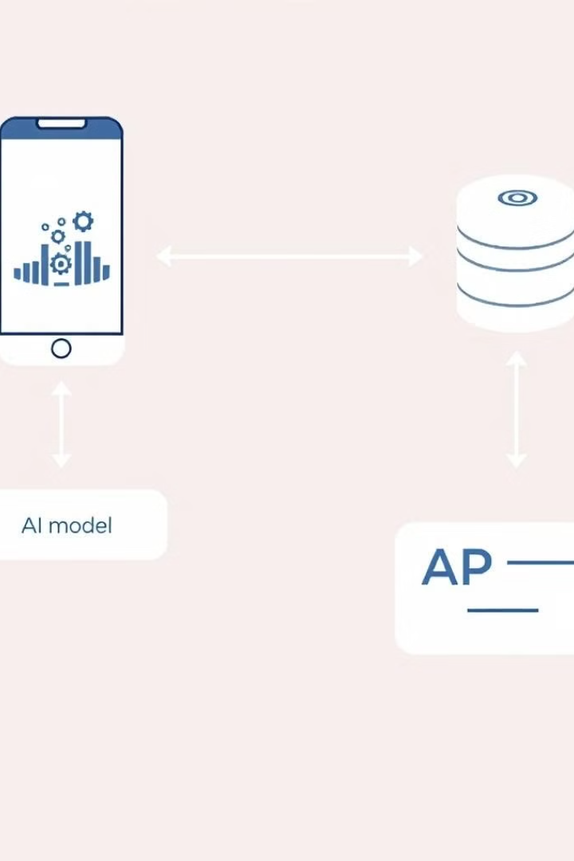
System Architecture
Our system integrates a React Native frontend, an AI model using deep learning, and a scalable Node.js with MongoDB backend. We use NGO locators, geolocation services, and reward partner APIs.
Notes:
1.7.2013
5
‹#›

Slide 6

Tech Stack
Frontend: React Native + Tailwind CSS
Backend: Node.js, Express.js
Database: MYSQL
AI: TensorFlow, OpenCV (image classification)
NLP: Google Speech API for voice listings
Notes:
1.7.2013
6
‹#›

Slide 7
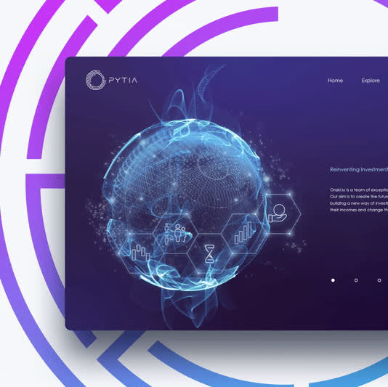
Why We're Unique
Snap & Detect: AI auto-detects items from photo
Voice Listings via WhatsApp: For rural or non-tech users
Eco Impact Dashboard: Live stats of your contribution
Gamification: Badges, leaderboards, Eco Points
Local-first Matching: No long logistics, just local love
Notes:
1.7.2013
7
‹#›

Slide 8

Business Model & Pitch
Freemium Access: Basic use is free; NGOs/partners get dashboards
Eco Points → Coupons: Partnered with green businesses
Sponsorship Model: Ads only from eco-conscious brands
NGO Collaborations: Verified collection & redistribution networks
Notes:
1.7.2013
8
‹#›

Slide 9

Impact & Statistics
70% of India's 62M tons of annual waste is reusable.
Gamification increases user engagement by 30%.
Pilot tests show 40% of listed items matched in 3 hrs.
Local NGO support improved by 60% via verified donations
Target: 10K+ users across 100 colleges in Year 1
Notes:
1.7.2013
9
‹#›

Slide 10

Thank You
Join us in reshaping sustainability! One snap, one share, one saved item at a time.
Notes:
1.7.2013
10
‹#›

